Slide 1

Filtering Patterns - Top-$k$ Pattern
CSC 4760 / 6760 Big Data Programming
Spring 2020

Slide 2
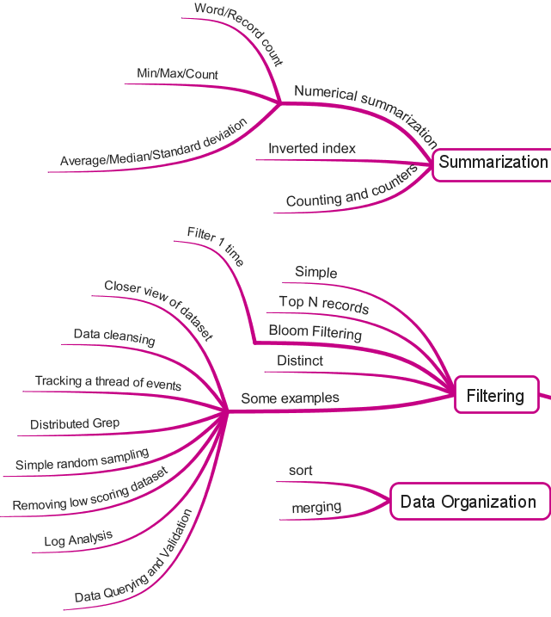
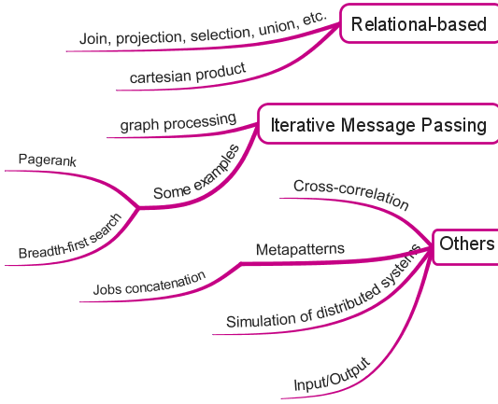
MapReduce Design Patterns
Contents Summary

Slide 3
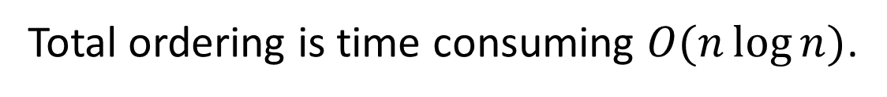
Top-𝐾 Pattern
Retrieve a relatively small number of top-$k$ records, according to a ranking scheme in your dataset, no matter how large the original dataset
You know how many records you will get in the end
Finding outliers is important in data analysis
Naïve solution: sort the data by the ranking value, then take the top-$k$ records from that.
Total ordering is time consuming $O(n\log{n})$.

Slide 4

Top-$k$ Pattern Could be interesting
Find out the limited number of high-value records without having to sort the data.
Plus, seeing the top-$k$ of something is always fun!
What are the highest scoring posts on StackOverflow?
Who is the oldest member of your service?
What is the largest single order made on your website?
Which post has the word “meow” the most number of times?

Slide 5
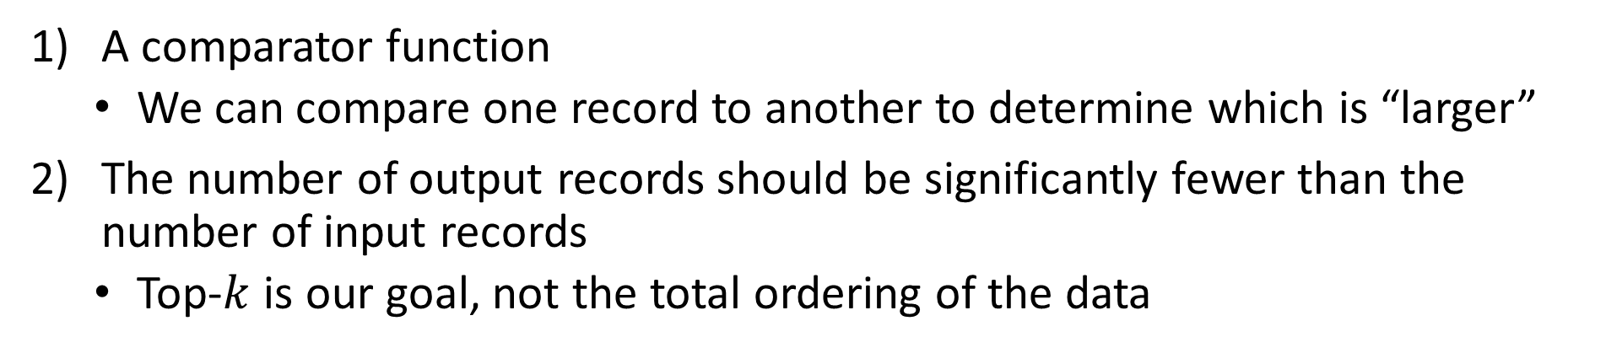
Features of the Problem
A comparator function
We can compare one record to another to determine which is “larger”
The number of output records should be significantly fewer than the number of input records
Top-$k$ is our goal, not the total ordering of the data

Slide 6
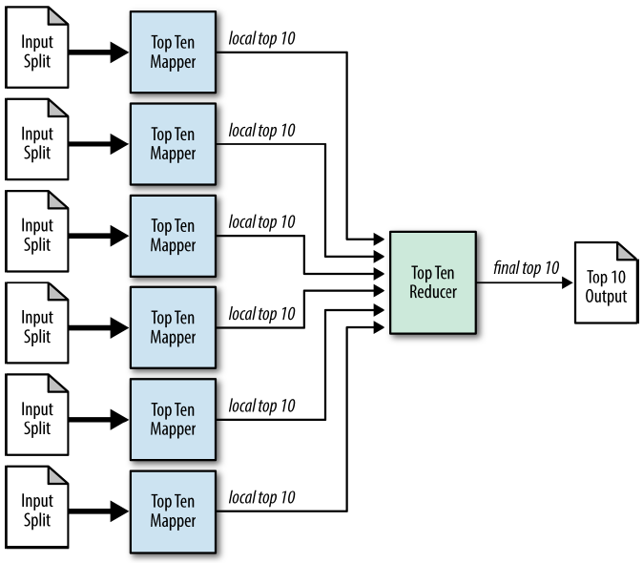
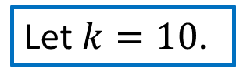

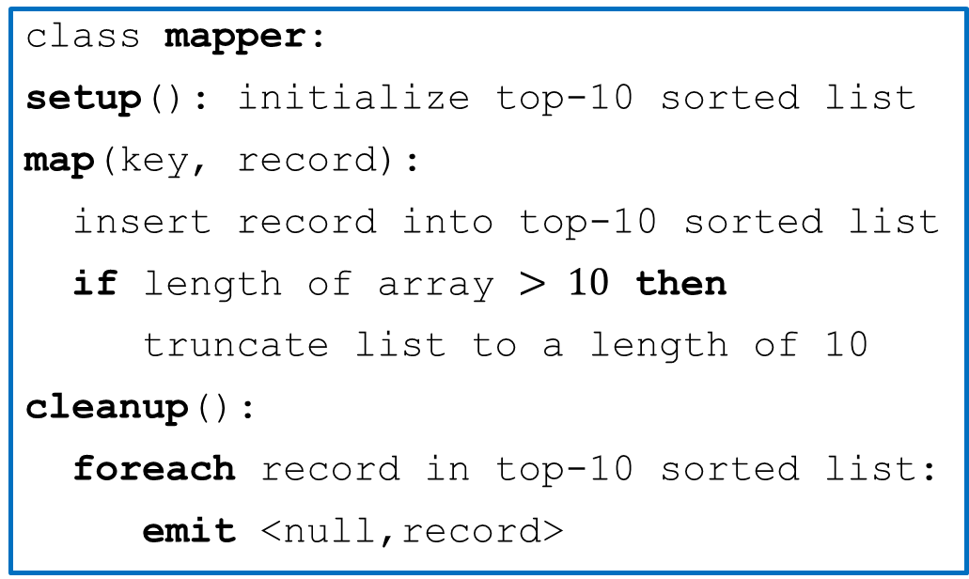
Structure
class mapper:
setup(): initialize top-10 sorted list
map(key, record):
insert record into top-10 sorted list
if length of array $> 10$ then
truncate list to a length of 10
cleanup():
foreach record in top-10 sorted list:
emit <null,record>
class reducer:
setup(): initialize top-10 sorted list
reduce(key, records):
sort records
truncate records to top 10
foreach record in records:
emit record
Let $k=10$.
Since $k$ is small, we only need once reducer.

Slide 7
Resemblances
SQL
SELECT * FROM table ORDER BY col4 DESC LIMIT 10;
“DESC” (descending order)
Number of limit is 10
Pig
B = ORDER A BY col4 DESC;
C = LIMIT B 10;
The ordering is expensive just to find a few top records.

Slide 8
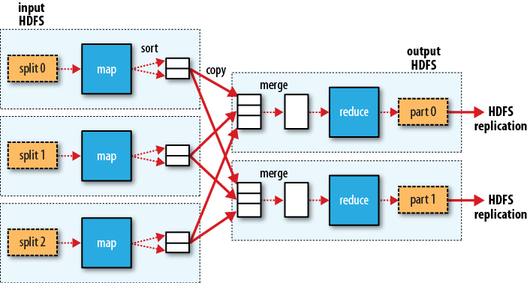
Performance
The performance is typically good.
The limitation is that we use a single reducer, regardless of the number of records.
Sort can be expensive
Network recourse hot spot
May out of memory
Writes to the output file is not parallel

Slide 9
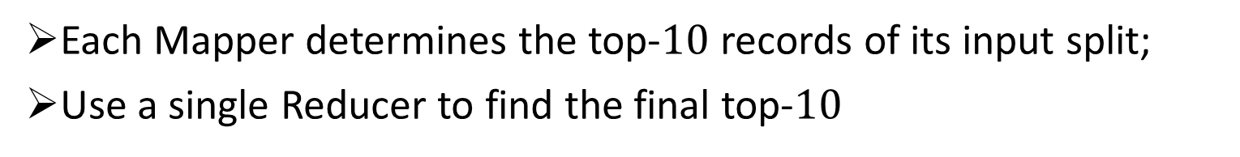

Problem – Top-$10$ Users based on Reputation
Given a list of user’s information, output
The information of the top-$10$ users based on reputation
Key Ideas:
Each Mapper determines the top-$10$ records of its input split;
Use a single Reducer to find the final top-$10$

Slide 10
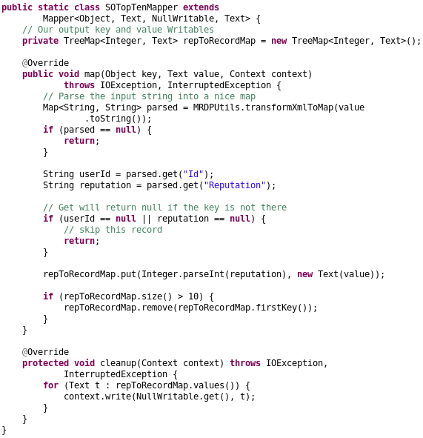
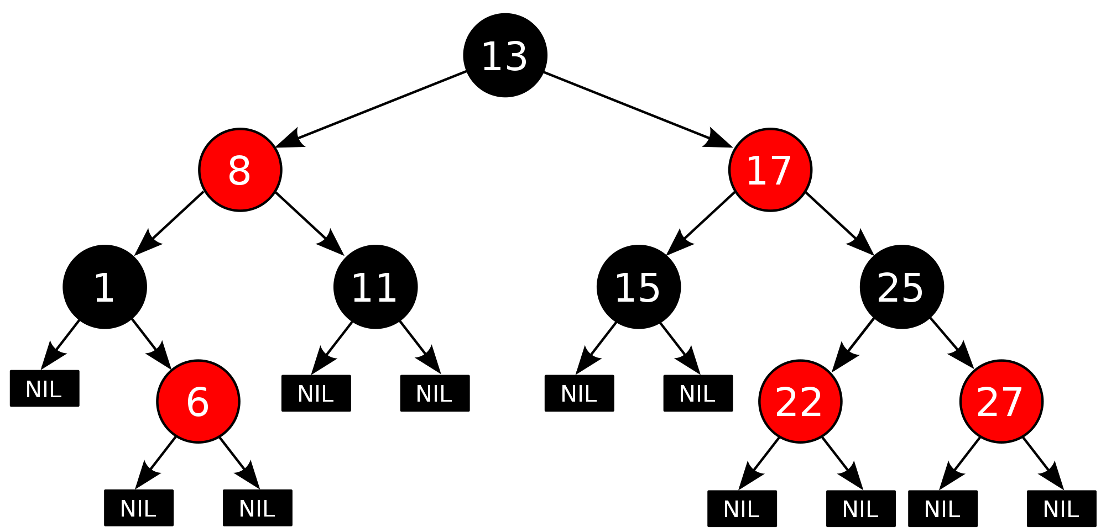
Mapper
The TreeMap class implements the Map interface by using a red-black tree. A TreeMap provides an efficient means of storing key/value pairs sorted in ascending order.
Source code “TopTenDriver.java”

Slide 11
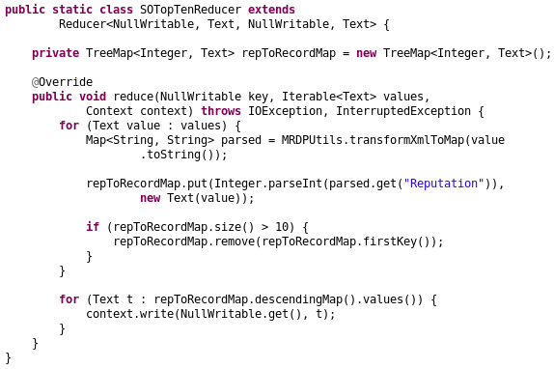
Reducer
Do we need a combiner?
Source code “TopTenDriver.java”

Slide 12
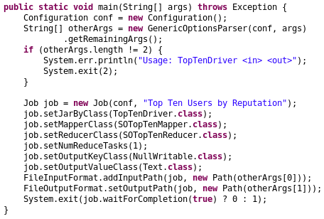
main function
Source code “TopTenDriver.java”

Slide 13
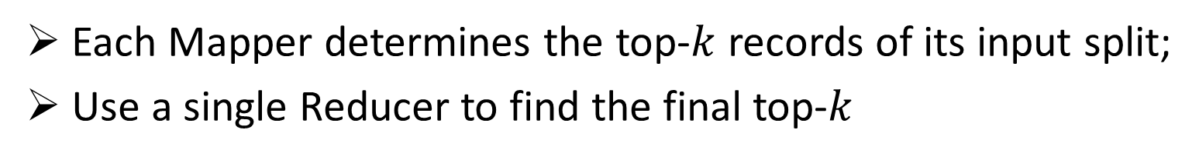

Problem – Top-$k$ Users based on Reputation
Given a list of user’s information and an input parameter $k$, output
The information of the top-$k$ users based on reputation
How to transmit the data from input parameter (command) to Mapper and Reducer?
Key Ideas:
Each Mapper determines the top-$k$ records of its input split;
Use a single Reducer to find the final top-$k$

Slide 14
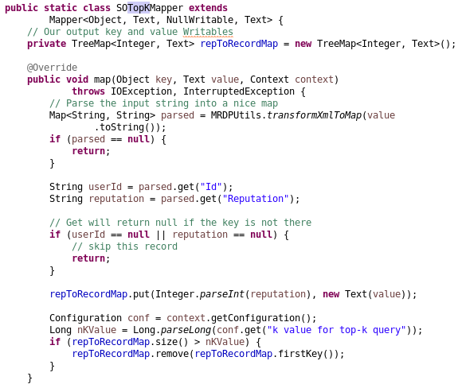
Mapper
Source code “TopK.java”

Slide 15
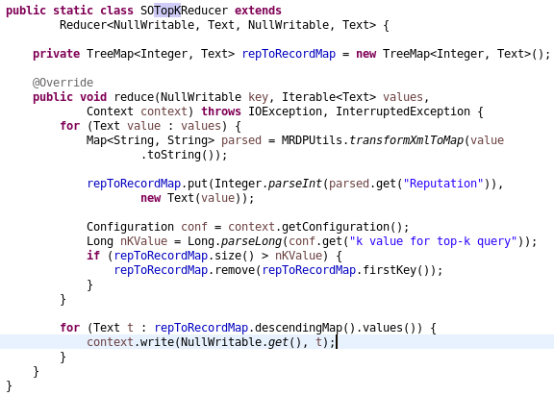
Reducer
Source code “TopK.java”

Slide 16
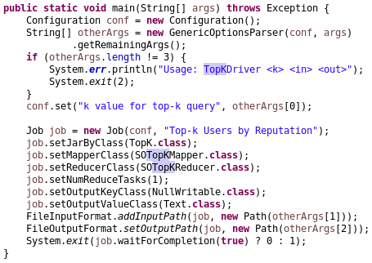
main function
hadoop jar TopK.jar 6 /user/cloudera/TopK/Input/Users.xml /user/cloudera/TopK/Output6
Source code “TopK.java”

